Slide 1


Group 3
FleetCor Project
Dhwani Pathak
Naga Sai Harika Mangina
Mathukutty Manoj
Johanna Susan Eapen
Sameer Shaik

Slide 2
Q1: How do Swap-In accounts perform compared to Do Not Target accounts in terms of key financial KPIs?
Total Payment: Swap-In accounts contributed $3.32B, compared to $3.70B from Do Not Target accounts. Net delta: −376.60M.
Net Revenue: Swap-In accounts yielded $160.03M vs. $197.84M for Do Not Target. Net delta: −37.81M.
Avg Vantage Score: Swap-In average is 722.10, higher than Do Not Target at 699.51.
Avg PAYDEX: Swap-In accounts show a healthier score of 77.55, compared to 65.87 for Do Not Target.
Insight: Despite lower revenue and payment, Swap-In accounts have stronger risk profiles (higher Vantage & PAYDEX).

Slide 3
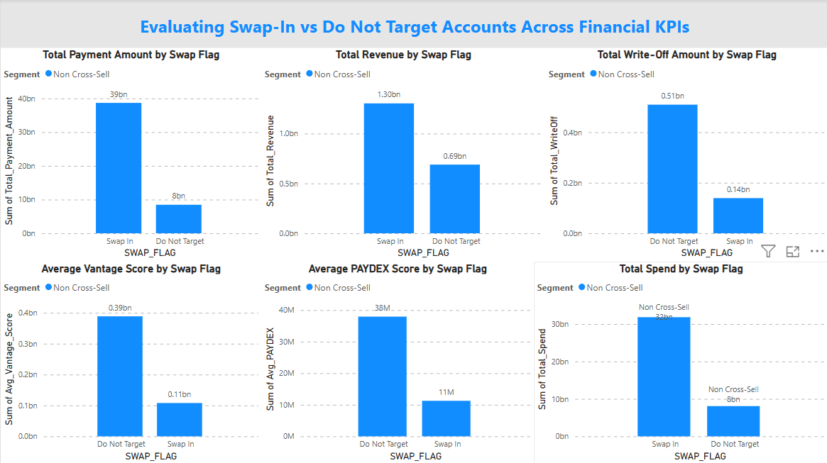

Slide 4
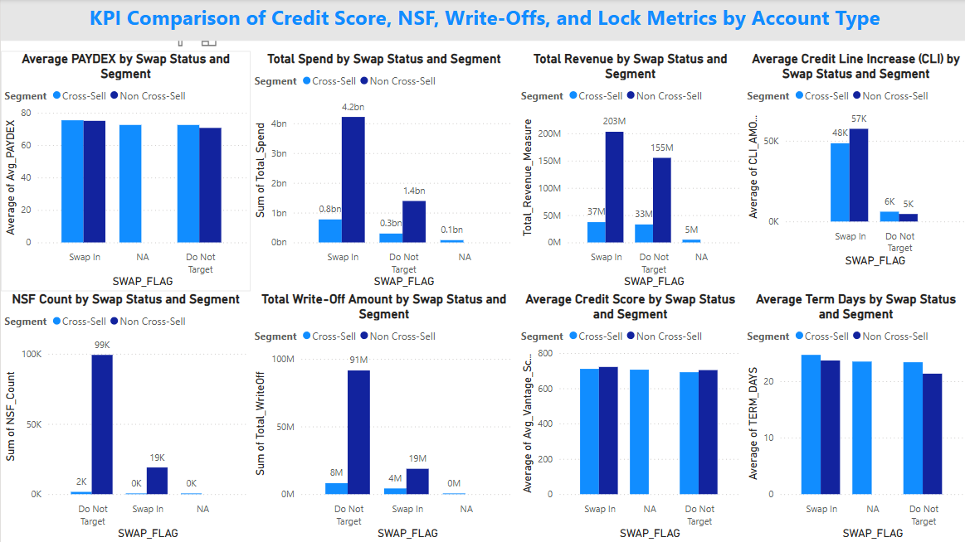

Slide 5
Q2: What is the segment profile of Non Cross-Sell accounts by Lock Type, Credit Grade, and Line of Business?
Lock Type: 63.12% of accounts are TEMP LOCK, 29.81% are PERM LOCK, and 3.07% are UNLOCKED.
LOB: Largest proportion from NAP (58.59%) and Fuelman (26.92%).
Credit Grade: Majority are B (32.41%) and A (31.15%).
Insight: Most accounts are locked and clustered around mid-to-high credit grades, primarily from NAP and Fuelman.

Slide 6
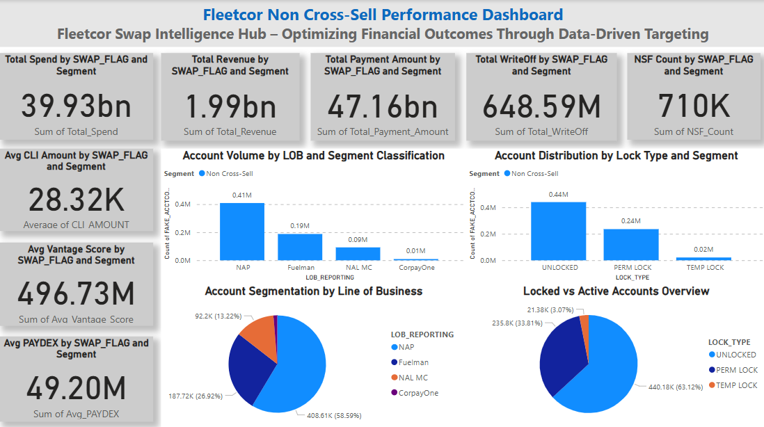

Slide 7
Q3: Who should be eligible for Swap-In based on payment and credit metrics?
Eligibility Rule: Accounts with good payment history, higher PAYDEX, Vantage score >700, and consistent CLI usage.
Eligible Accounts Identified: 6,434 accounts flagged for Swap-In.
Insight: Eligible Swap-In accounts show strong risk-adjusted returns.

Slide 9
Q4: What risk indicators should be used to Swap-Out accounts?
Swap-Out Indicators: High NSF count, low PAYDEX (<60), credit grades of F/X/C2, and PERM LOCK status.
Identified Swap-Out Accounts: 431,180 flagged.
Insight: Swap-Out logic helps reduce exposure to underperforming, locked, or high-risk segments.

Slide 10
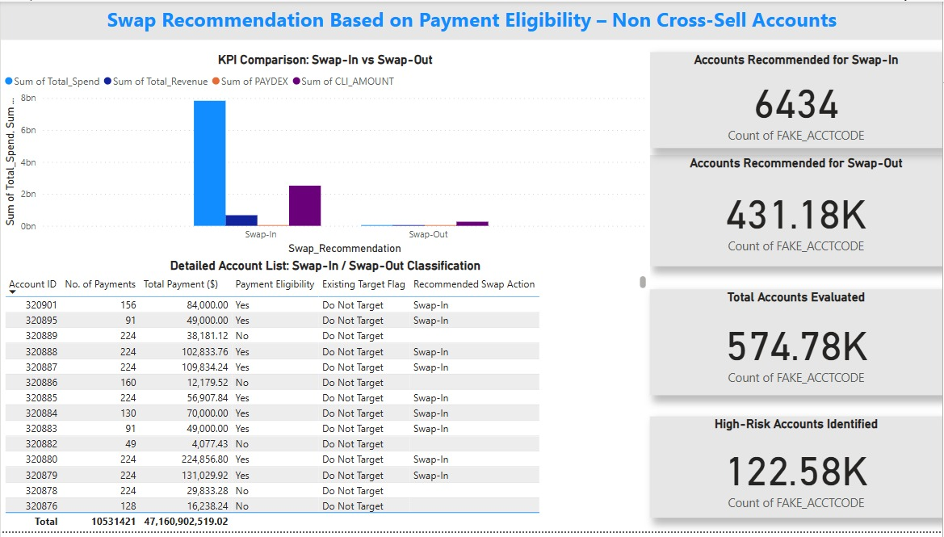

Slide 11
Q5: How do Cross-Sell vs. Non Cross-Sell accounts differ across KPIs and risk metrics?
Avg Credit Score: Cross-Sell = 708 vs. Non Cross-Sell = 720
NSF & Write-Off Risk: Cross-Sell shows significantly lower writeoffs and NSF counts
Lock Days: Cross-Sell accounts experience fewer lock days on average
Insight: Cross-Sell accounts are financially healthier and should be scaled.

Slide 12
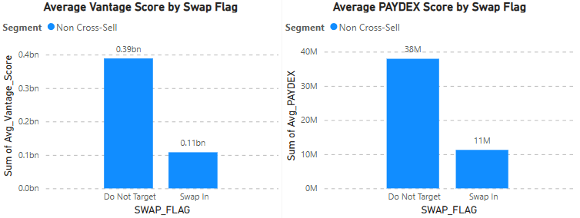

Slide 13

Final Recommendations to FleetCor
1. Prioritize Expanding Cross-Sell Programs: These accounts show lower delinquency, fewer lockouts, and stronger credit metrics (Avg PAYDEX = 72.33 vs. 71.46 for Non Cross-Sell).
2. Use Eligibility Metrics for Controlled Swap-In: Leverage high Vantage Score, strong PAYDEX, CLI activity, and low NSF as triggers for conversion. Already identified 6,434 eligible accounts.
3. Implement Swap-Out to Mitigate Risk: Accounts with low PAYDEX, high NSF counts, poor credit grades (C2, F, X), and long lock durations should be targeted for phase-out.

Slide 14
Final Recommendations to FleetCor
4. Track Key KPIs Over Time: Monitor changes in Avg CLI, PAYDEX, Vantage Score, and Write-Offs to refine eligibility models.
5. Collect Additional Data: Track exogenous factors like market segment behavior, macroeconomic risk scores, and time-series CLI usage to further enrich analysis.
6. Refine Portfolio Strategy: Segments like NAP and Fuelman dominate volume but show varying financial strength. Tailor strategy by LOB.

Slide 15
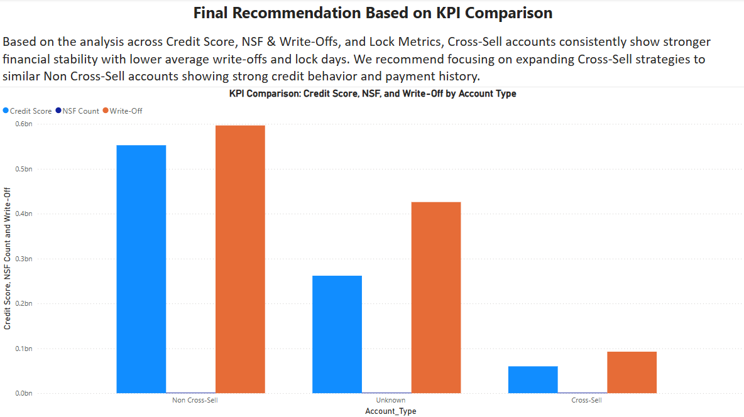

Slide 16


